Slide 1

Made by Vaibhav Chaudhary

Slide 2
What is Git?
Git is a distributed version control system, which is free and open source. Created by Linus Torvalds, the developer of Linux operating system kernel, in 2005. Git is used for project collaboration and history exploration.
Version Control System: Version control refers to the practice of tracking and managing changes to software code, and Version Control Systems refers to software tools that assist software teams in managing changes to source code over time.
Distributed VCS: Every participating node in distributed VCS has a complete copy of the project as well as a full revision history of each file. This allows you to work locally without a network connection all while allowing you to collaborate when you are back online via central remote repositories.
Notes:
Basically, it is a software which stores the snapshots of the versions of your code and lets you come back to any version at just a click.
Version Control System means that if you accidentally delete a file or make a mistake, you have nothing to worry about, you can just recover them.
VCS can not only restore your previous working version, but it can also solve other concerns with code management and application deployment.

Slide 3
Why do we use it?🤔
Trace the changes made to the code
Simplify code review
Modify code efficiently
Maintaining multiple versions of the code
Better collaboration and improved productivity
Lightweight and fast
Notes:
Traces changes and lets you revert back to any previous versions of the file, or whole project, monitor changes, who updated what in which version and why…
Find errors by checking what updations were made in what versions
Imagine having a time stone to go back and rectify your mistakes, create a new tangent in the time axis and manage messed up things, it just is the tool
Requirements always change, new features added or older ones removed can be done in different branches and merged later if everything goes well
You can work with your team on the same project in different branches and merge the things later on. This decreases interdependence in team, thereby increasing the productivity
Almost everything in git is done locally on computer and then can be uploaded to GitHub at the end of the day. Further the source code of git is in C, which is anyways fast.

Slide 4
How it works?
Three main areas where code lives:-
Working tree: It contains the files we are currently working on.
Staging area: It contains all the added files having new/changed code. All new/changed files are first added to the staging area before commit.
Repository: It contains all the files of the project.
Every file goes through 3 stages:
Modified: File is modified/changed in this stage.
Staged: Modified files sent into staging area.
Committed: Files are committed to reflect the changes and store in the database.
Notes:
Repository can be local or on some hosting service as GitHub or bit bucket, etc.
Can be pushed to remote repository as well after committing.

Slide 5
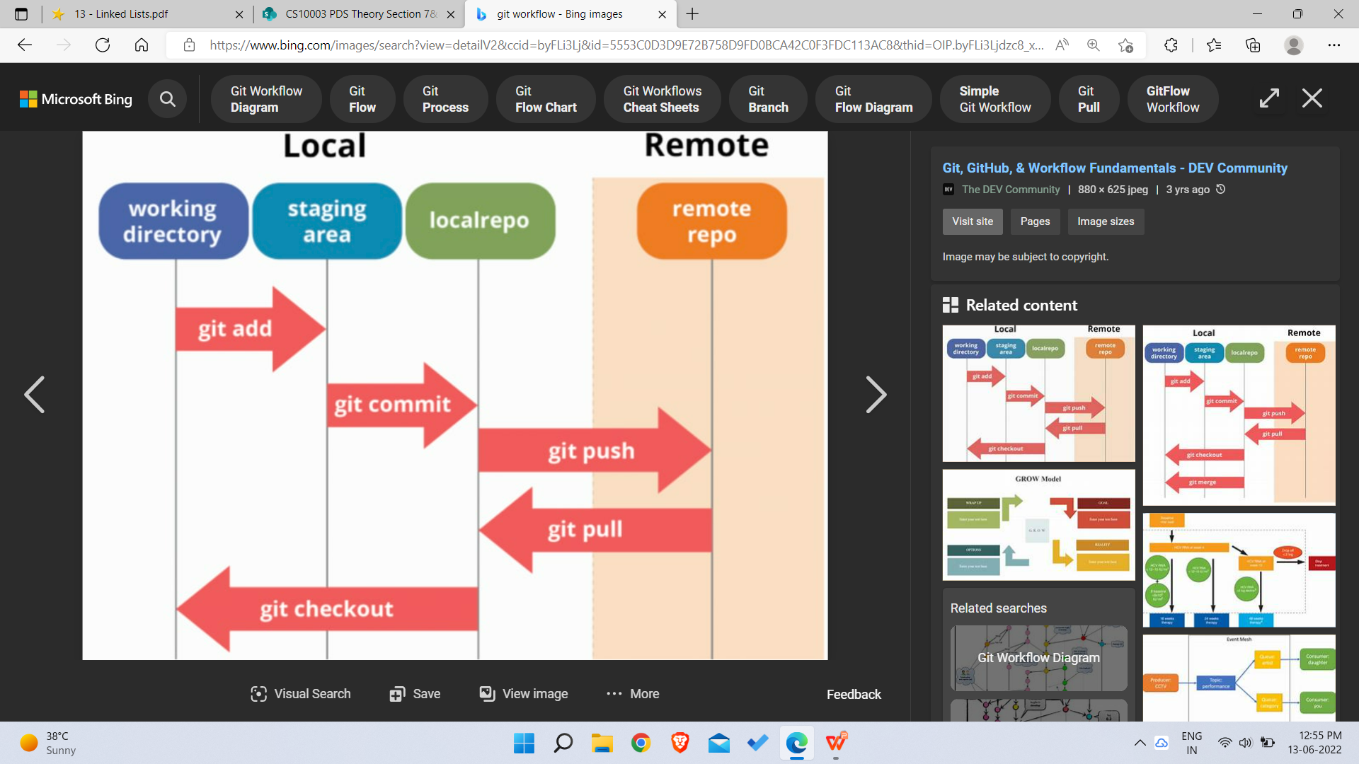

Slide 6
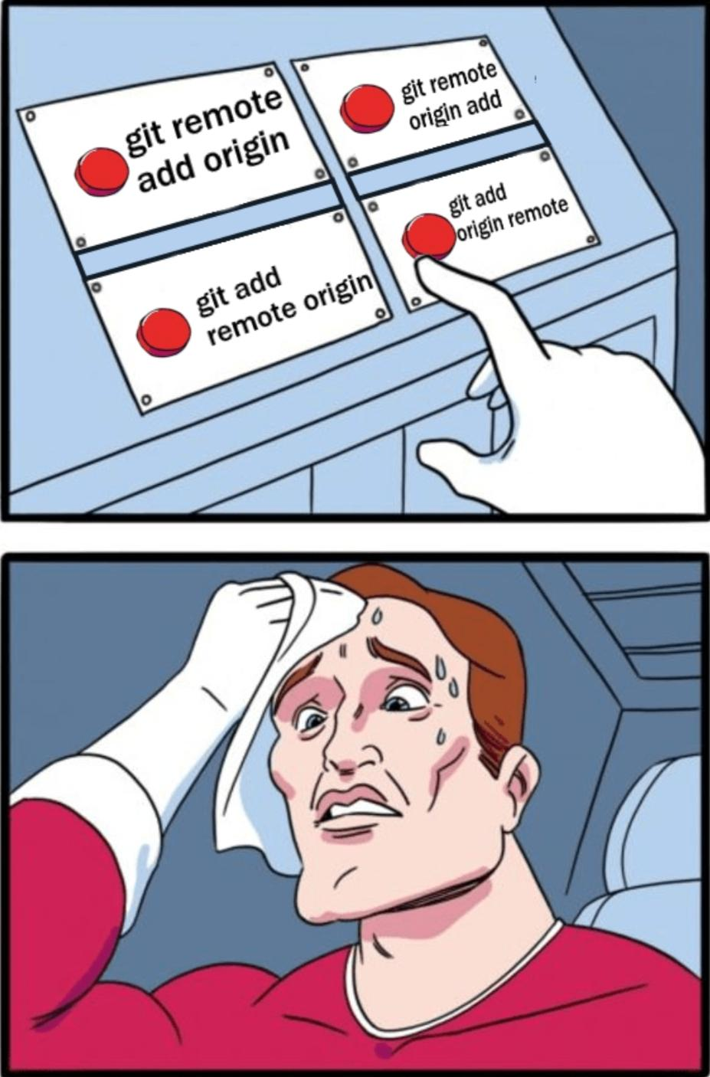
Newer Git concepts…

Slide 7
Git stash
Git stash enables you to save your code without making a commit. It stores a snapshot of your code locally in a folder and reverts to previous commit.
Use?
Imagine working on a project, we’ve forgot to create a new branch and are working on main, and we are debugging a code or are working on a feature. Now, while working, things start to mess up and for some reason we have to switch branches immediately. So, in this scenario, we don’t want to commit or push these changes before removing the debugging code or completing the work.Now, Git stash is here to save us. What it does is that, just like a commit it stores the snapshot of the code and changes, in a folder and reverts the main branch to the previous commit. So, now we can navigate to any branch and work as we like and then come back whenever we want, and get our changes as we left them before. Just stage the files and stash them.

Slide 8
Commands: (Files must be staged)
git stash -- Uncommitted code is stored in stash and the state is reverted to previous commit.
git stash list -- See the list of stashes.
git stash branch <feature> -- Switches to a new branch named ‘function’ and sends the stashed files to that branch as unstaged files.
git stash apply stash@{n} -- Apply whichever stash you want.
git stash drop stash@{n} -- Drop a stash you no longer want to use.
git stash clear -- Remove all stashes.
git stash pop -- Restore most recently stashed files.

Slide 9
Git bisect
Git bisect helps us to discover the commit that has introduced a bug in the code. It helps to track down the commit, where the code works, and the commit, where it does not, hence tracking down the commit which introduced the bug in the first place. Uses binary search.
Use?
It is helpful when we are not exactly sure when a specific change happened in the code, which introduced the problem. It may be very hard to track the error manually and so, git bisect saves us the labour.
Ex - We have a bug, but we are sure enough that it was not there a week ago. It is difficult to manually check all the commits made during the week. So, we use bisect. Here, commit made a week ago is a good commit. And, the current commit is a bad commit. Now, binary search starts.
Notes:
Good commit is the one, where the functionality is working fine.
Bad commit is one where things are not working as expected.

Slide 10
Working:
The binary search starts with two commits, a good and a bad, and bisects the commits and checkouts the middle one for us and create a detached HEAD to check whether that particular commit is good or bad. And, inputs the feedback from the user that whether that particular commit is a good one or bad. If the commit is good, it now searches between the new found good commit and the bad one. Else, if the commit is bad, it now searches between new found bad commit and the good one. And, the process continues to narrow down the search to that particular commit which introduced the problem. And, now we know which commit caused the problem and who made that particular commit. So, we got the commit causing problems in a detached HEAD and now we can work around with them, make experimental changes and commit if all goes well, without impacting any branch.
From this state, we can take this commit to a new branch and work around.
{good, good, good, ....... , bad, bad, bad} -- That’s how we reach to the first bad commit.

Slide 11
Commands:
git bisect start : To initialise the search.
git bisect bad : Label the commit as bad.
git bisect good : Label the commit as good.
git bisect reset : Reset branch to its normal working state.

Slide 12
Git reflog
Git maintains a list of checkpoints which can accessed using reflog. We can use reflog to undo merges, recover lost commits or branches and a lot more. It basically helps us to rewrite history. Git log just shows the history of commits. But, git reflog, instead, shows not only the commits we made, but each of the actions that led us there. It is like a safety net that records almost every change we make in our repository. It can be used to reset changes and commit the correct code, or recover lost commits.
We have a reflog of HEAD (by default this opens), a reflog of branches, a reflog of stash, a reflog of remotes, etc. It shows all of the changes made and helps us to restore, if there is some problem. We also have timed reflogs(1.day.ago, yesterday, 1.month.ago, etc.).
Actually, commits are never being lost in Git, even during history
rewriting.
Notes:
HEAD is the last checkout point in the recent history.

Slide 13
Commands:
git reflog: The most basic command, will output the HEAD reflog.
git reflog <branch_name>: Output reflog of that particular branch.
git reflog stash: Output reflog for a git stash.
git reflog show --all: Gives complete reflog of all refs.
git diff master@{0} master@{1.week.ago}: Filter git reflogs by time, gives difference in branch now and 1 week ago.
git reflog master@{0}: Display one line log for the passed.
git reflog expire: By default, expiry date is 90 days. Can be changed if required.
git reflog delete: Deletes passed reflog entries.

Slide 14
Git diff
A diff takes two data sets and shows you what has changed between them. The diff will compare the differences between the two commits, showing what files were added, deleted, or modified. When examining the diff of each file, added lines of text are commonly highlighted in green or denoted with a + sign. Similarly, deleted lines of text are commonly highlighted in red or donated with a – sign.
Why?
Diffs provide useful information about your repository in a legible format, making it easier to perform the following actions:
Review changes while staging.
Decide whether to rebase or merge a branch.
Copy and paste code from a file.

Slide 15
Commands:
git diff: Shows all of the uncommitted changes since the most recent commit.
git diff commitId1 commitId2: Changes between the two commits.
git diff branch1 branch2: Changes between the two branches.
git diff --staged: Changes between previous commit and current staged files.
git diff HEAD: See all staged and unstaged changes.
git diff file_name: Difference in that file between current state and previous commit.
git diff HEAD^ HEAD: Changes between previous and present commit.
git diff --stat branch: View summary of changes

Slide 16
Git switch
It is a fairly new command whichis used to switch between branches as well as create new branches. It was introduced very recently to decrease the load on git checkout, which was already loaded much with other commands. Also, it created confusion, especially in the minds of beginners. So, git switch was introduced, but git checkout was also continued, so as not to create a problem for people familiar with the previous commands. So git switch is essentially a new way to switch between branches.
An example of confusion due to git checkout is:-
git checkout <file_name> : Reverses the modifications of unstaged file.
git checkout <branch_name> : Switches to the branch.

Slide 17
Commands:
git switch example: Switches to example branch.(Searches for remote branch if local is not available with that name)
git switch - : Switches to the previous branch without using branch name again.
git switch -c example : Creates a new branch example and switches to it.

Slide 18
Git rebase
It is a git utility designed to integrate changes from one branch onto another. Rebasing is the process of moving or combining a sequence of commits to a new base commit. As the name suggests, it is moving or combining a sequence of commits to a new base commit. When we rebase, it is done in a linear manner.
Why?
For maintaining a linear project history. We want to get the latest updates(to the main branch) in our feature branch, but want to keep our branch's history clean so it appears as if we've been working off the latest main branch. Or, a real world scenario can be like a bug is identified in the main branch, now to debug the code, we want a cleaner history, so that using git log or git bisect becomes easier and we are quickly able to find out the bug.

Slide 19
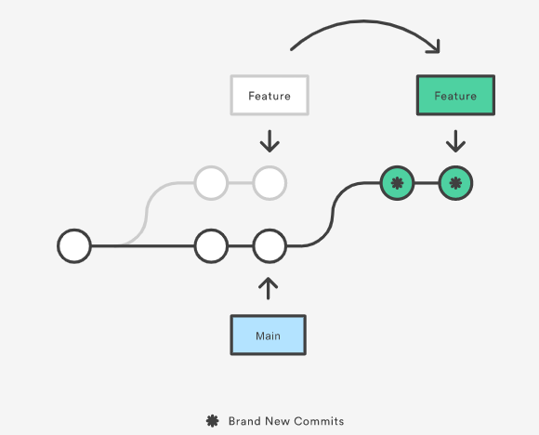

Slide 20
Git merge vs Git rebase
Creates a final commit at merging
All commits merged as a single one
Graphical history, complex to understand
Can be done on private or public branch
Preserves history
Presents all conflicts at once
No new commits are made
A linear track of commits is made
Linear history, easier to understand
Do not do this on public branch
Rewrites history
Presents conflicts one by one
Commands:
git rebase <base>: Performs the standard rebase.(to be given from branch which is to rebased, and base is the branch where it is to be based now)
git rebase --continue: Continue with the changes we made after solving conflict, and carry the rebasing forward.
git rebase --skip: Skip the changes and ignore that particular commit which brought those changes.
git rebase --interactive <base>: Provides an interactive method to do rebase.
Notes:
On public branch if you do git rebase then it may cause problem for the people who are pulling that, because it will overwrite their commits.
And, then to resolve that, you will have to use git reflog.

Slide 21
Git cherry-pick
It stands for applying some commit from one branch into another branch. In case we made a mistake and committed a change into the wrong branch, but do not want to merge the whole branch. We can revert the commit and apply it on another branch. A cherry-pick looks at a previous commit in the repository history and update the changes that were part of that last commit to the current working tree.
Use?
Team Collaboration: One person created a code, which is to be used by other members as well, then they can cherry pick that particular commit.
Bug Fixes: When a developer finds a bug and fixes it, everyone can cherry pick that commit to fix the bug.
Avoid useless commits: Instead of using git merge, we use cherry-pick, and
avoid useless commits to get into our branch.

Slide 22
Commands:
git cherry-pick <commit-id>: Cherry pick your desired commit.
git cherry-pick -x <commit-id>: Use this to cherry pick your desired commit from the public branch.

Slide 23
Thank You!

